Slide 1

SWEETS SHOP MANAGEMENT
DessertDeck

Slide 2

Submitted by:
ANIKET RAJENDRA KALE – 236306
OMKAR ARJUN KAMBLE - 236358
Guided By: Prof. Dr KAVITA KHOBRAGADE

Slide 3
Introduction
The DessertDeck (Sweet Shop Management) system is a comprehensive web application designed to manage an online Sweet Shop.
It allows customers to browse and purchase a variety of sweets, while providing an interface for administrators to manage products, orders, and customer information.
The web- application is built using Django, Python web framework.

Slide 4
Features
User Registration:
Users can create accounts, log in, and log out.
Password management.
Product Catalogue:
Display of products with details such as name, description, price, and image.
Search and filter products.
View Cart:
Add, update, and remove items.
View total price.
Order Placement and Tracking:
Place orders .
Track order status – Pending , in progress and deliverd .
User Profile Management:
Update personal information and view order history.

Slide 5
Admin Panel: - Manage products (add, delete). - Manage orders (view, update status). - Manage users (view, update, delete accounts)

Slide 6
MODULES
User module
View Products
Product Booking
View Cart
Give Feedback
View Product Bookings
Administrative module
Manage Products
Manage Booking
Manage Customers
Manage Feedback

Slide 7
SCOPE & PURPOSE
The scope of the proposed computerized sweet shop management system includes:
Computerizing a sweet shop management system offers numerous benefits that streamline operations, enhance efficiency, and improve customer experience. Here are some key points highlighting the need for computerization:
Real-Time Tracking: allow real-time tracking.
Accurate Records: Keeps accurate records of ingredients, products, and materials and ensuring freshness.

Slide 8
Online Ordering: Integration with online ordering platforms to cater to the growing demand for online shopping.
Convenient Shopping: Allow customers to browse a wide range of sweet products, view details, and make purchases from the comfort of their homes.
Computerizing a sweet shop management system transforms the way the business operates, leading to enhanced efficiency, better financial management, improved customer satisfaction, and scalability for future growth. Implementing such a system is a strategic investment that can drive long-term success

Slide 9
PURPOSE:
To manage the online shopping of sweets. It helps to customer to book products from anywhere.
Also make payment on delivery.
It helps to people to book desired products at their prefer time.

Slide 10
LANGUAGE USED
HTML (HYPERTEXT MARKUP LANGUAGE)
CSS (CASCADING STYLE SHEET)
BOOTSTRAP (FRAMEWORK OF CSS AND JS)
PYTHON
DJANGO
SQLITE (DATABASE)

Slide 11
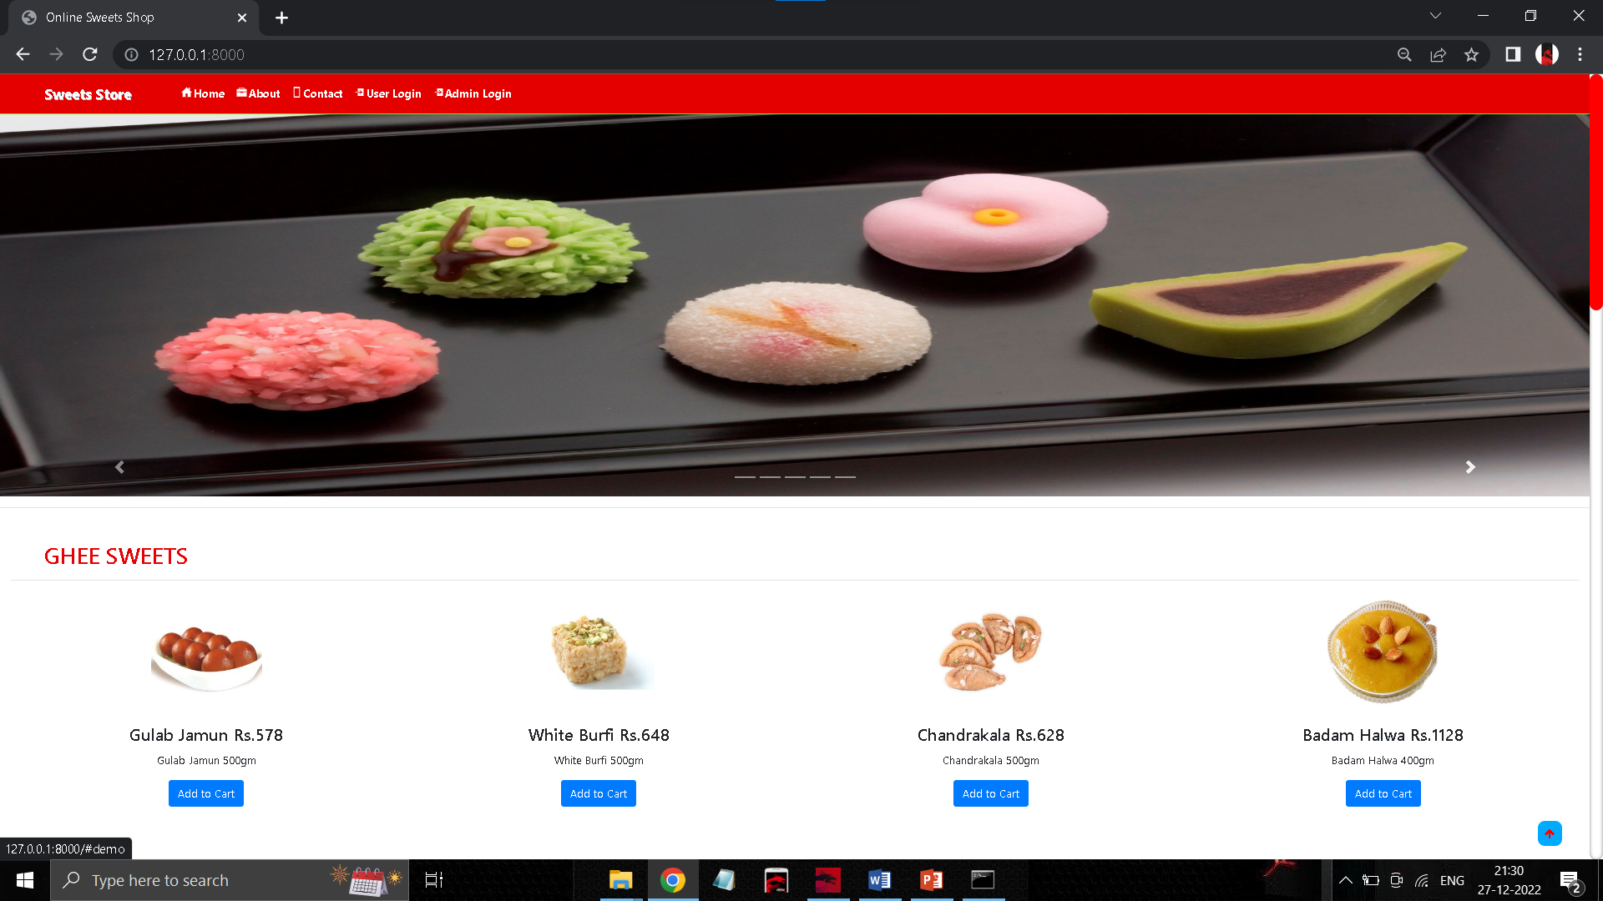
HOME PAGE

Slide 12
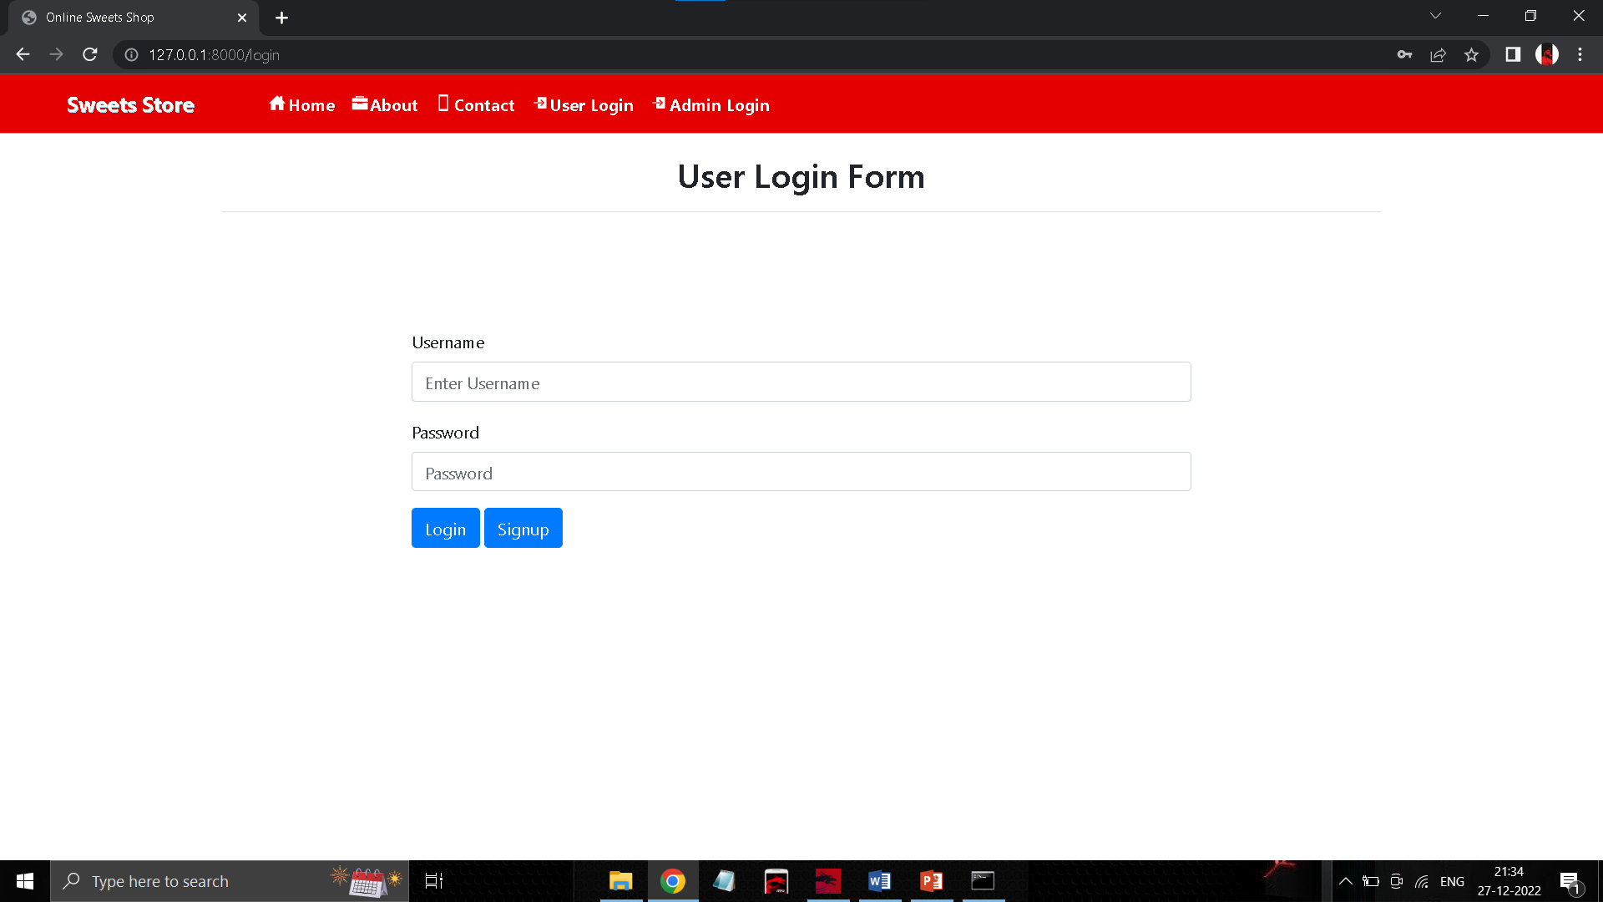
USER LOGIN PAGE

Slide 13
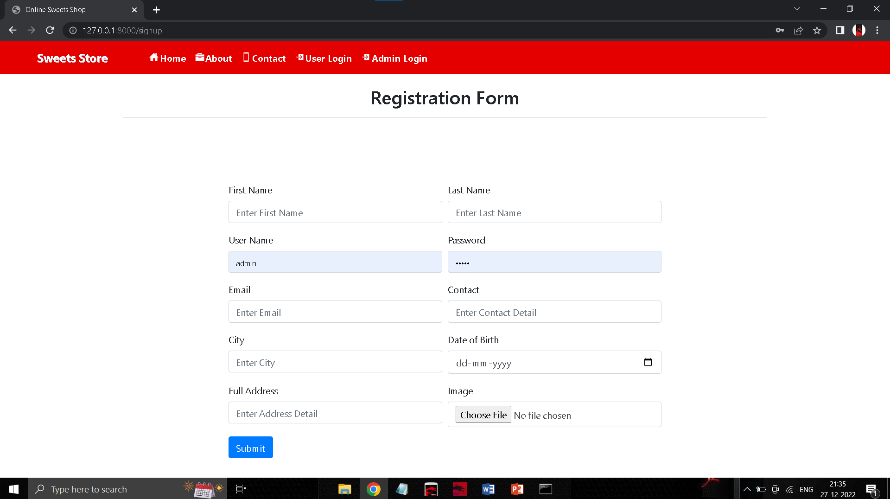
USER REGISTRATION PAGE

Slide 14
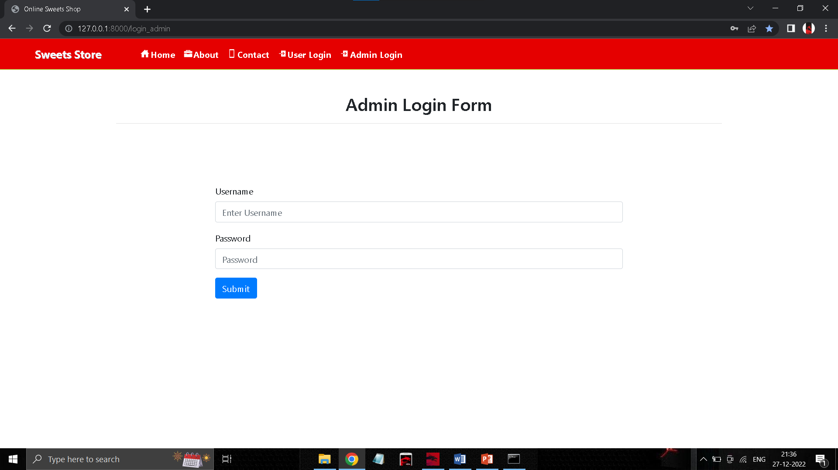
ADMIN LOGIN PAGE

Slide 15
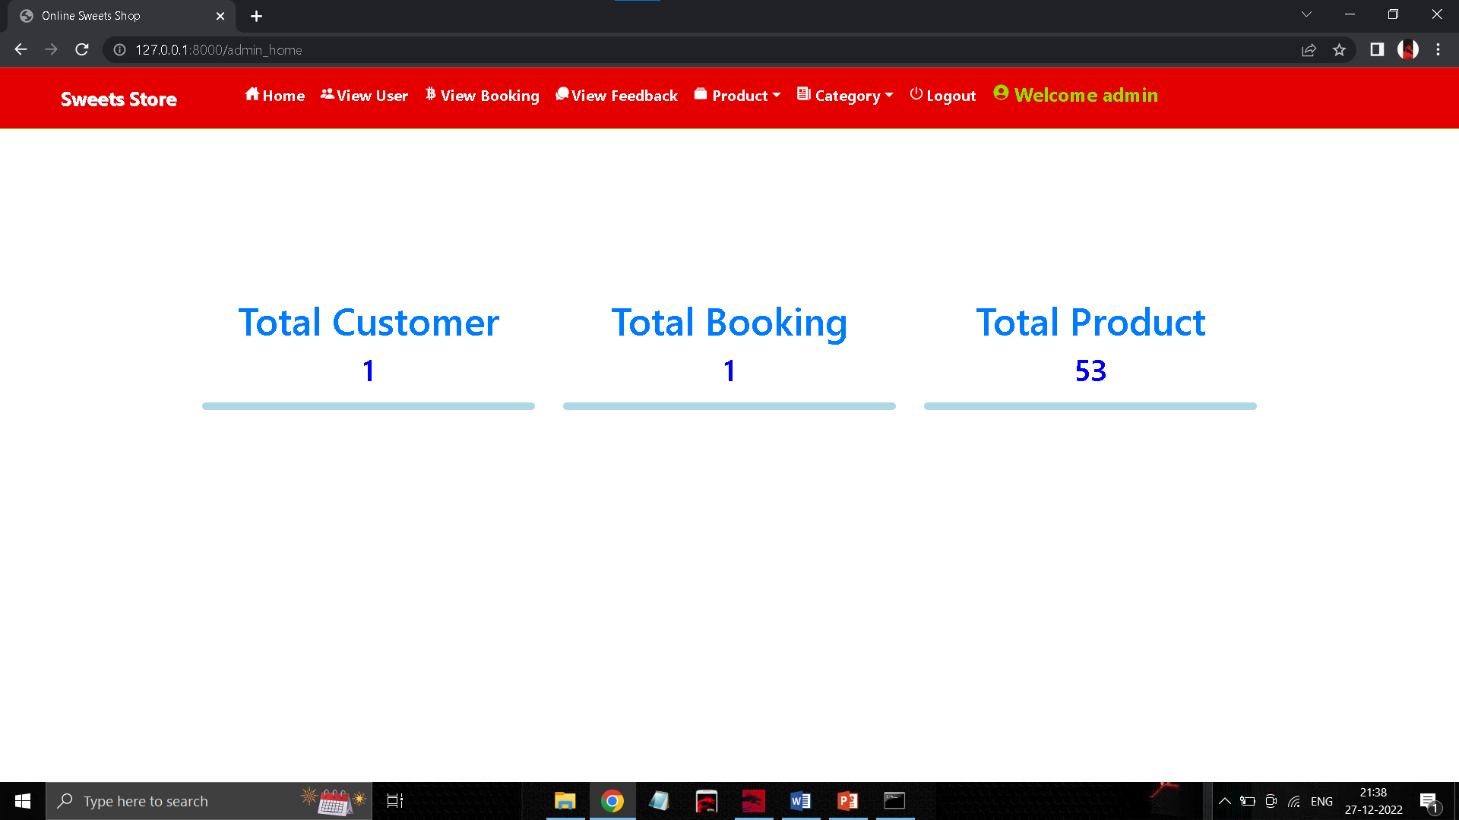
ADMIN HOME PAGE

Slide 16
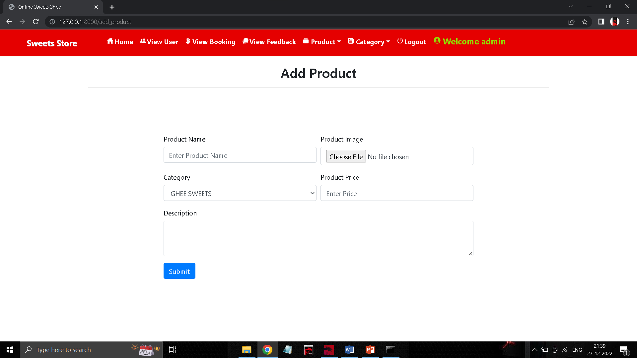
ADD PRODUCT PAGE

Slide 17
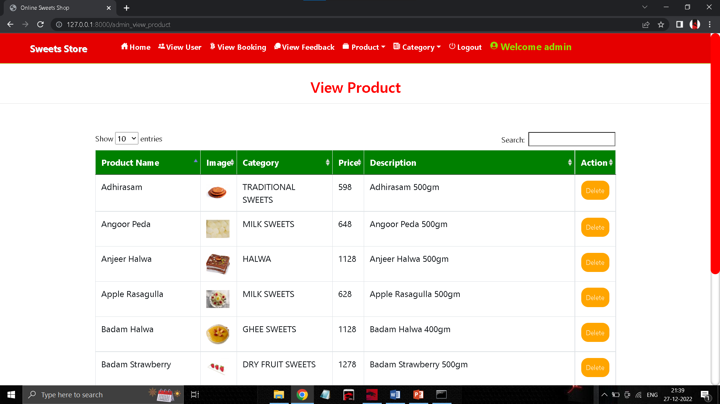
VIEW PRODUCT PAGE

Slide 18
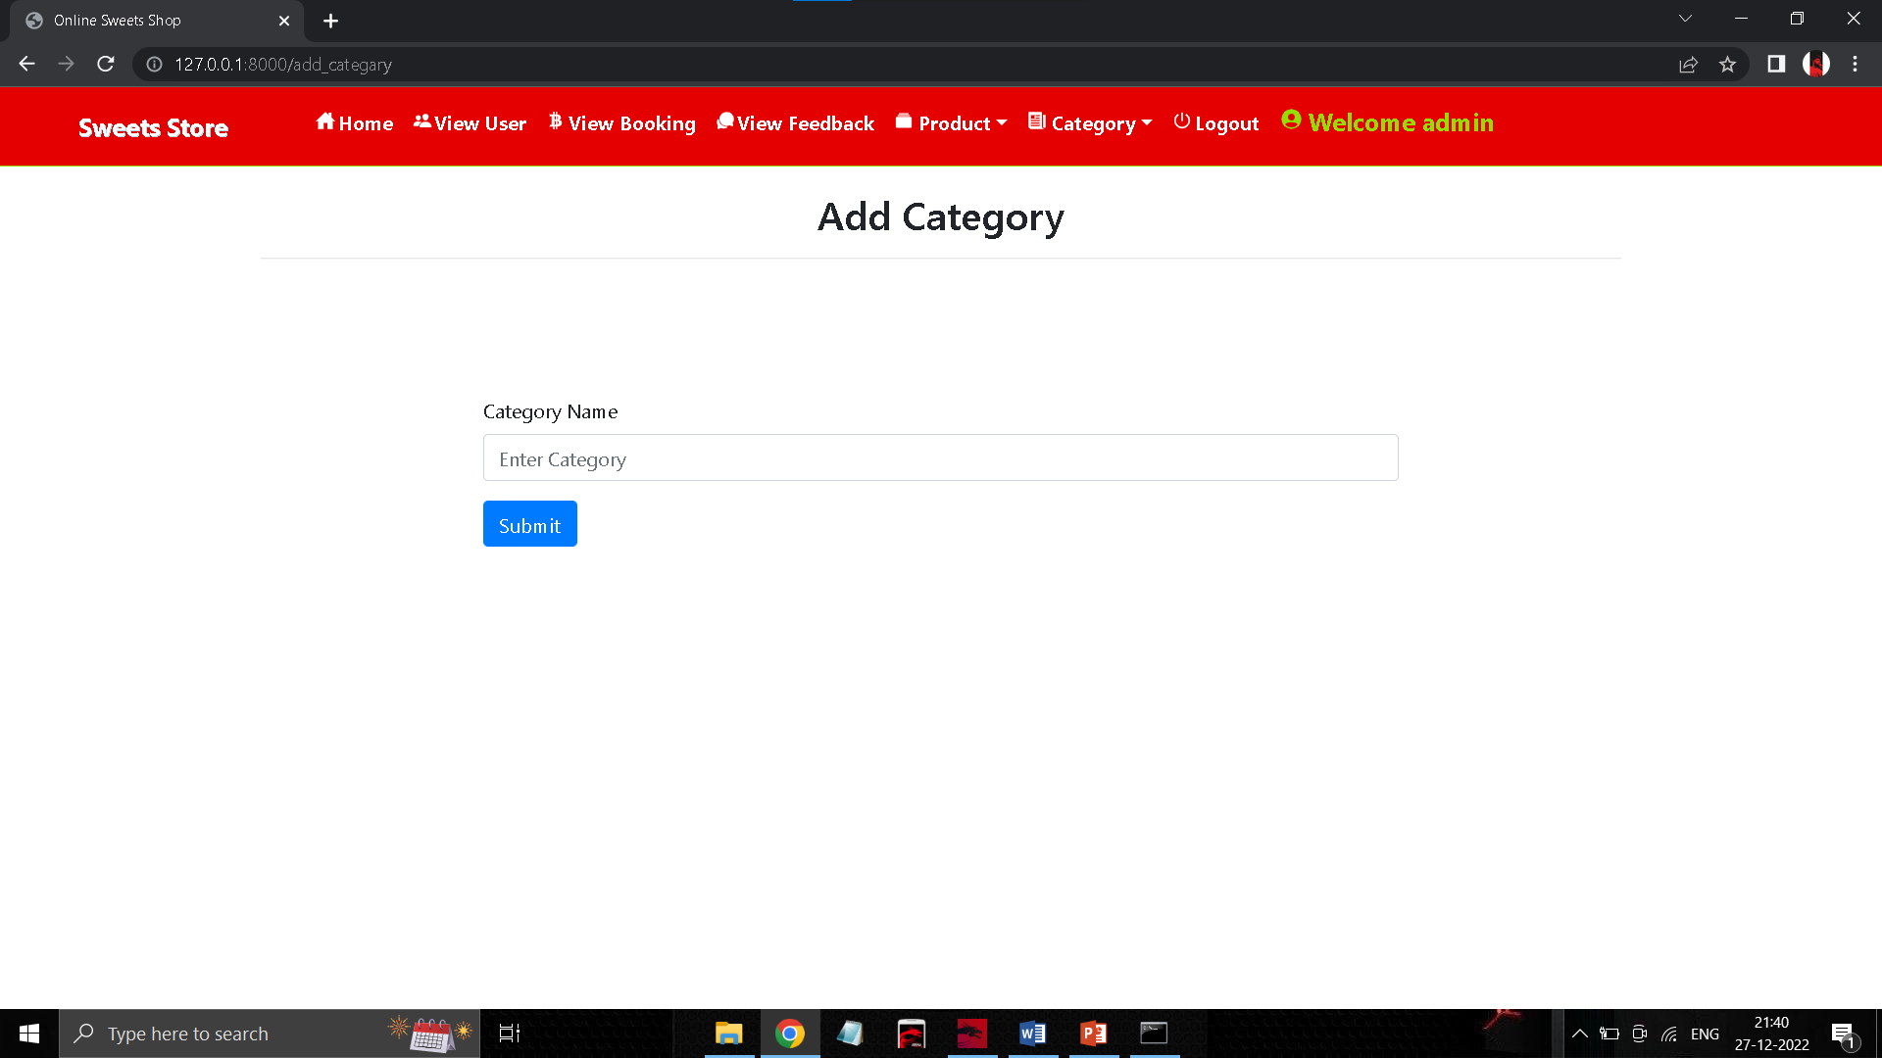
ADD CATEGORY PAGE

Slide 19
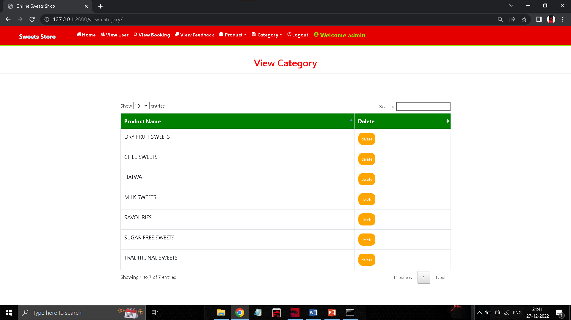
VIEW CATEGORY PAGE

Slide 20
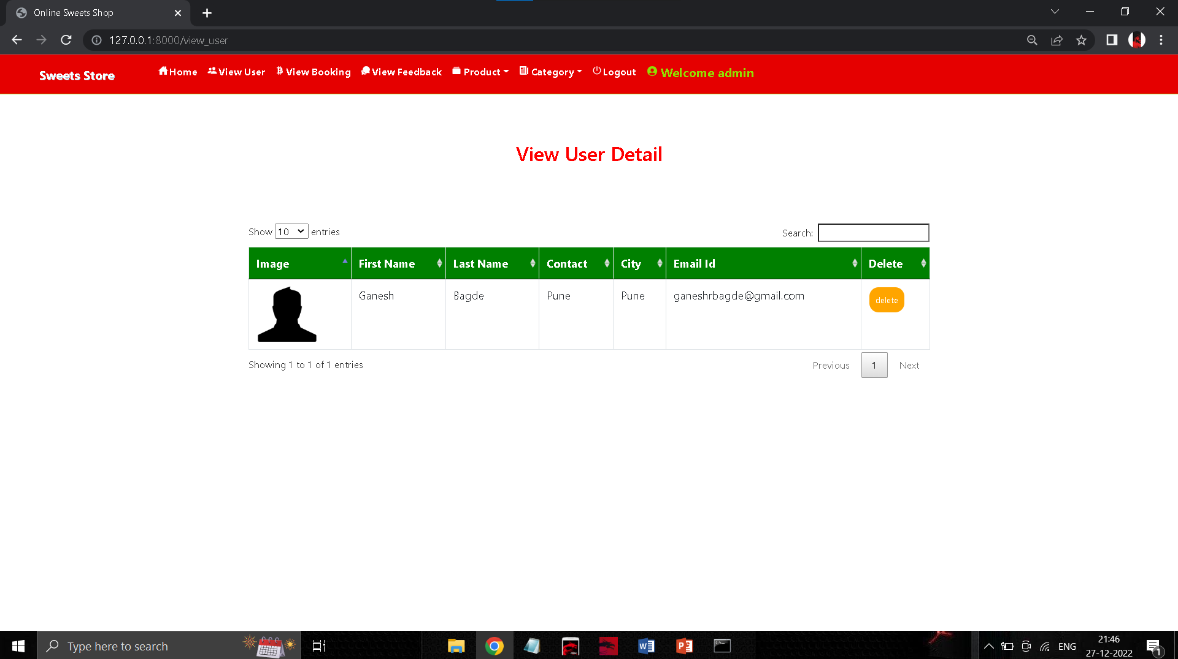
VIEW USER DETAILS PAGE

Slide 21
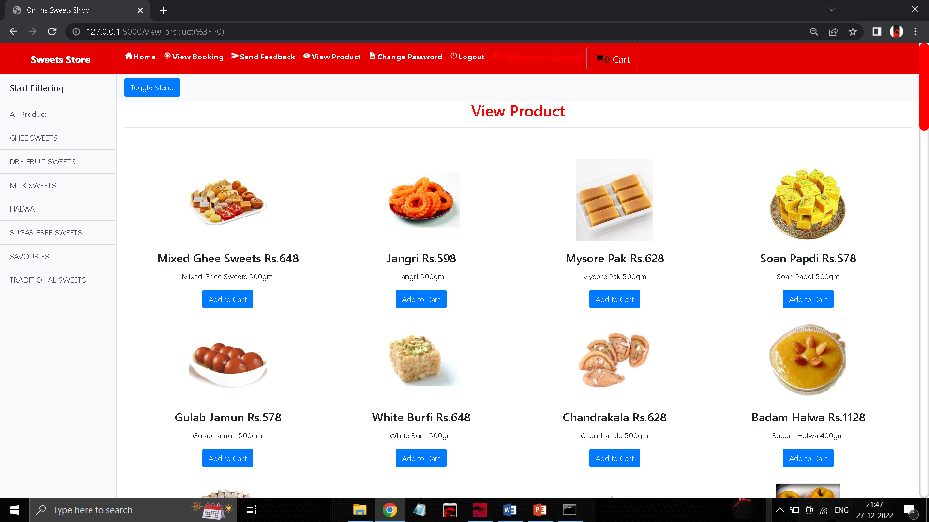
VIEW PRODUCT PAGE(USER)

Slide 22
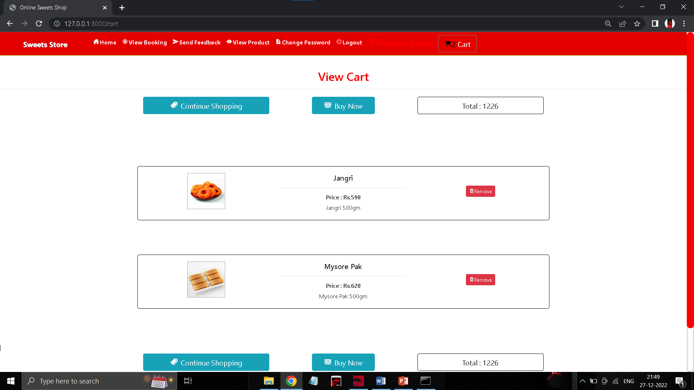
VIEW CART PAGE(USER)

Slide 23
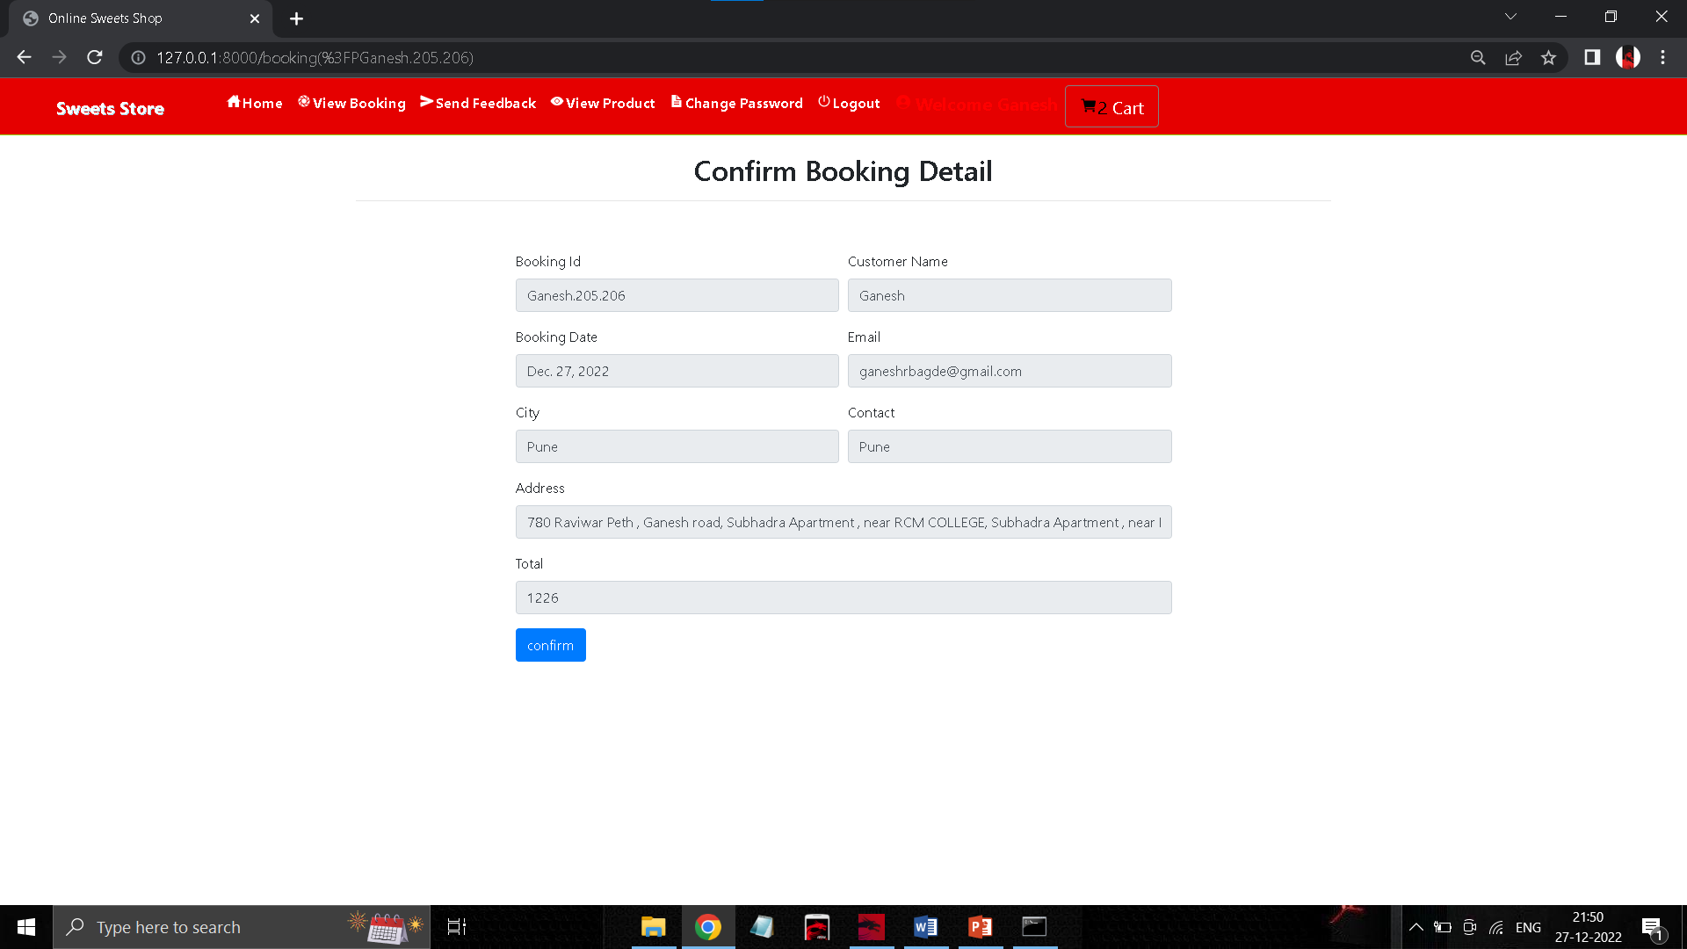
CONFIRM BOOKING PAGE(USER)

Slide 24
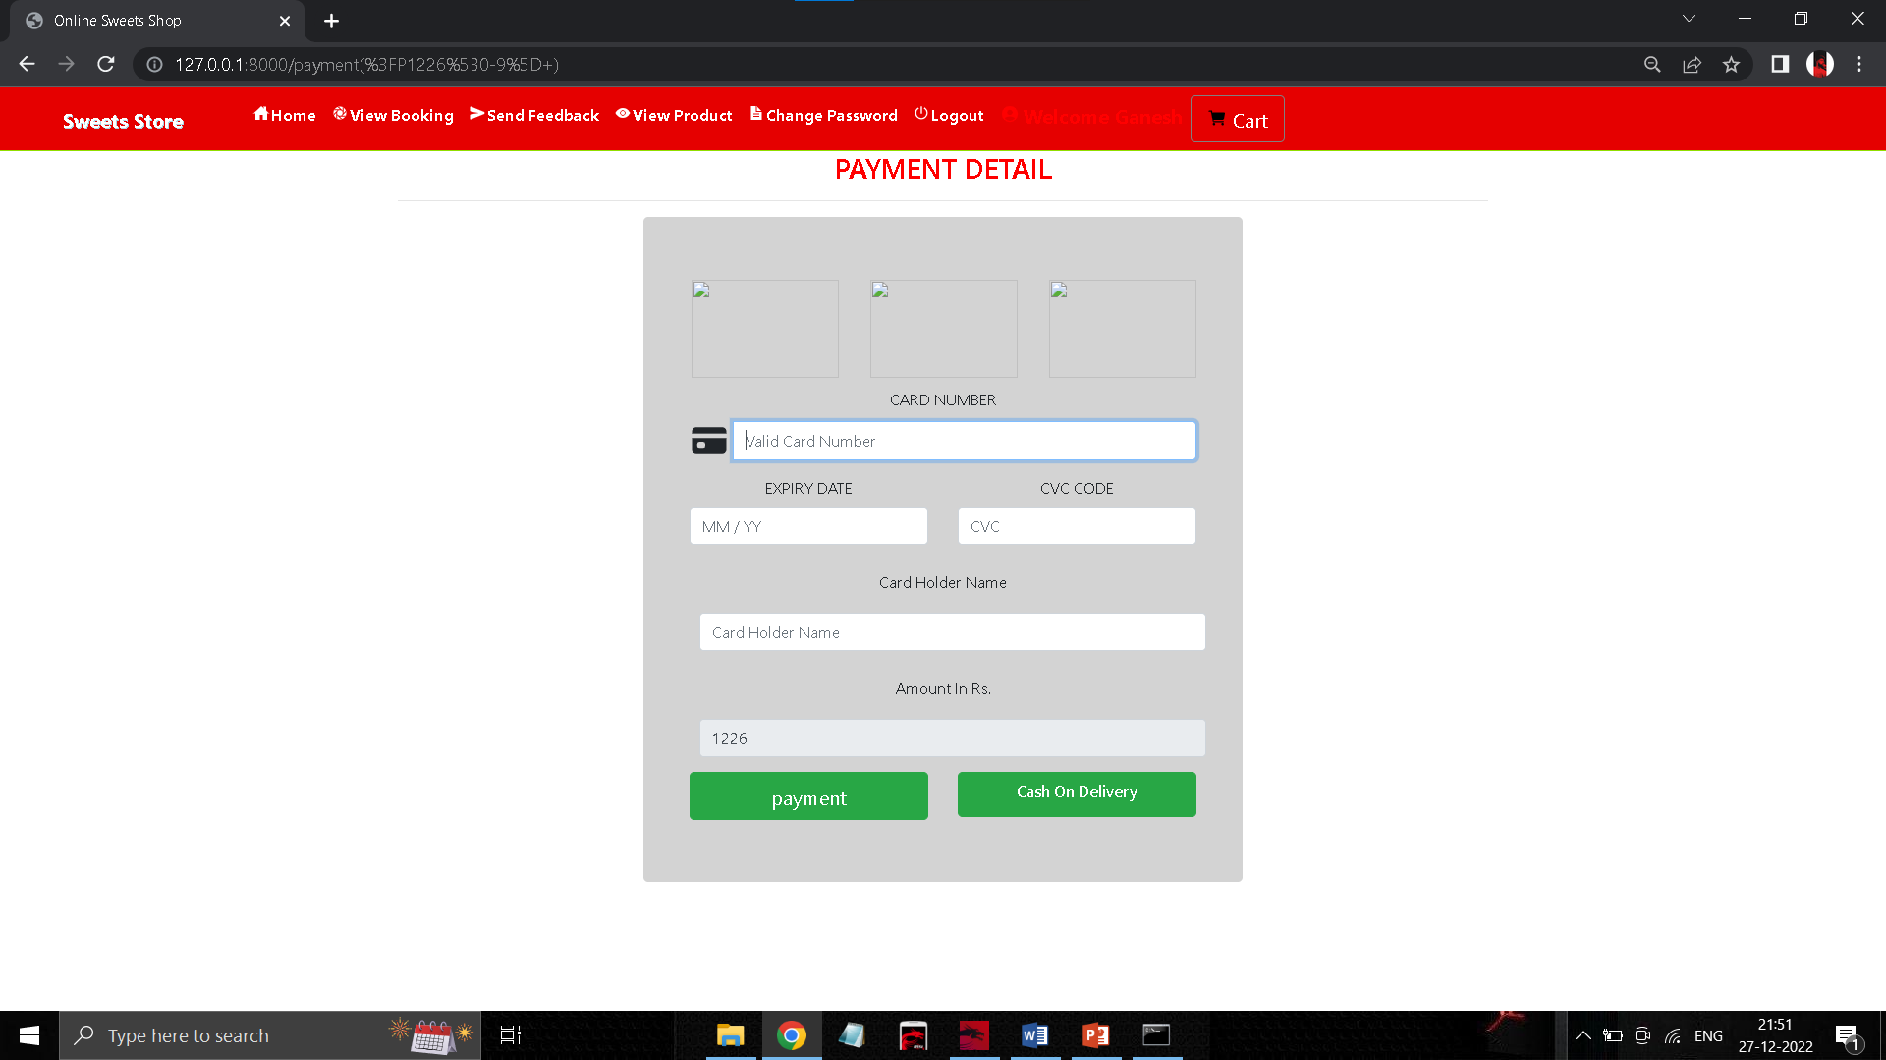
PAYMENT DETAIL PAGE(USER)

Slide 25
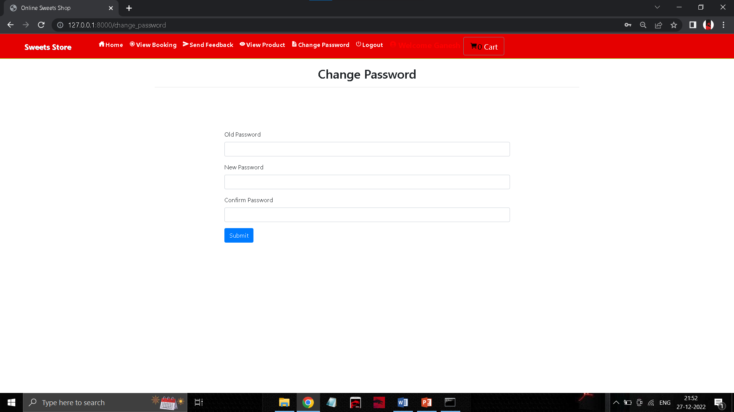
CHANGE PASSWORD PAGE(USER)

Slide 26
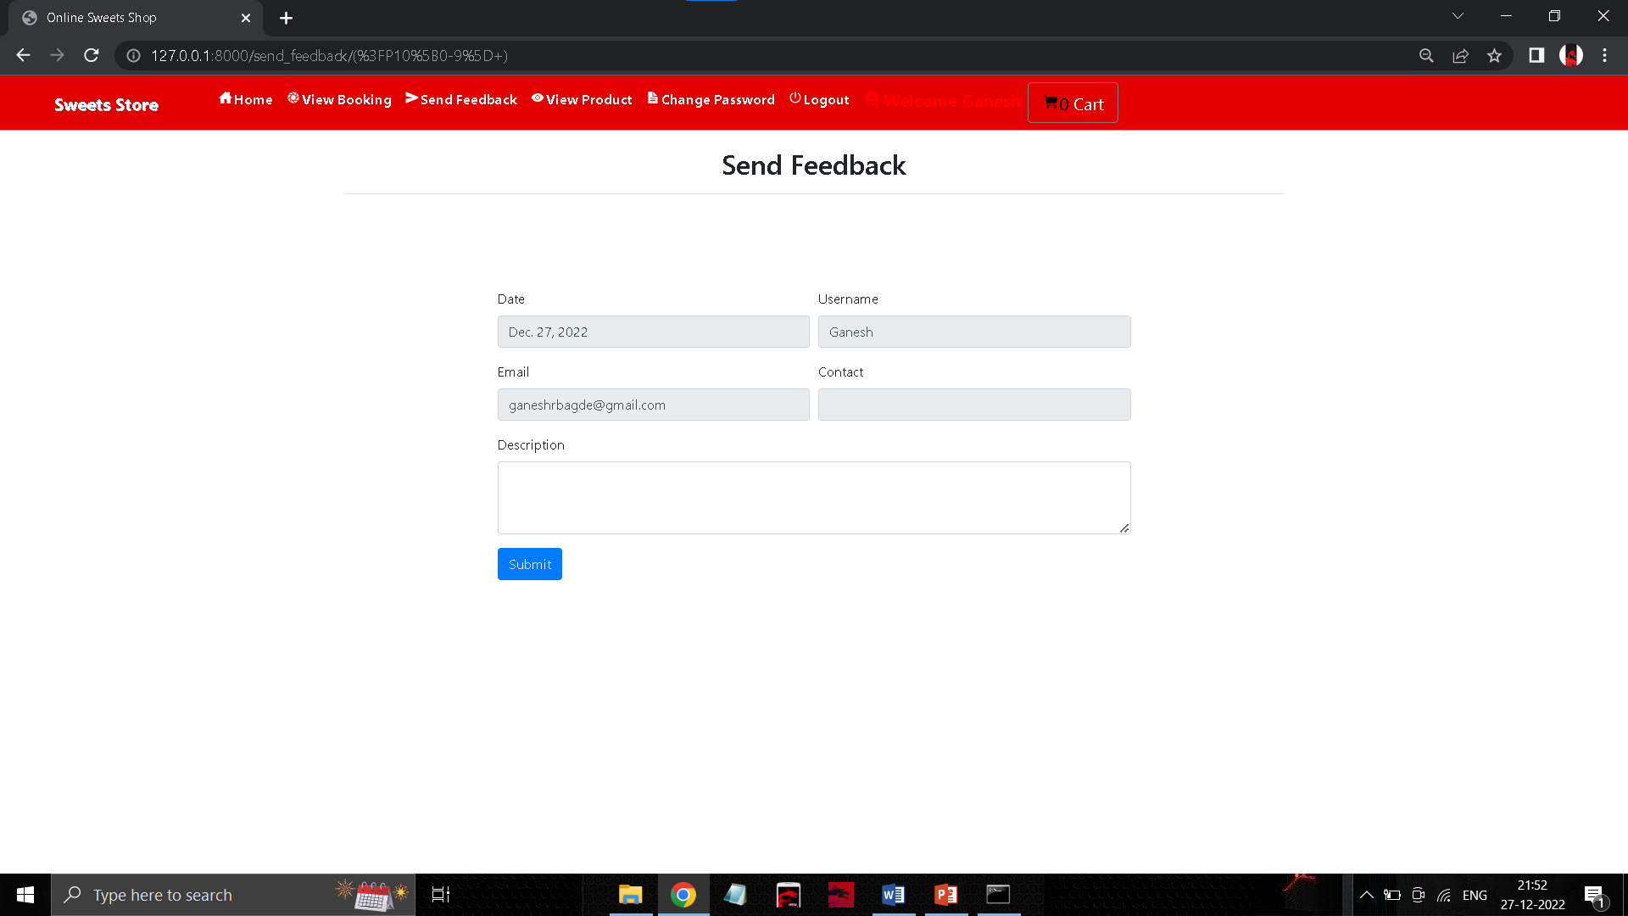
SEND FEEDBACK PAGE(USER)

Slide 27
ER DIAGRAM(Admin)
UID
Password
Delete
User booking
Update status
Admin
Login
Product
Delete product
Add product
Name
Img
Price
Description
Category

Slide 28
ER DIAGRAM(User)
name
Uid
address
Uid
New User
Register
Login
Password
DOB
Password
img
Email-id
Add to cart
Product
No
Buy product
Card
Yes
Payment
CoD

Slide 29
USE CASE DIAGRAM(Admin)
Manage Products
Manage
Users
Manage Booking
Admin
System
Manage Feedback

Slide 30
USE CASE DIAGRAM(User)
Booking
Cancel Booking
Search Sweet
Feedback
USER
Edit Profile
SYSTEM

Slide 31
SEQUENCE DIAGRAM (admin)
Home
View–User,booking,Feedback
Product/Category
Logout
To make changes
Changes update
Login
Add, Delete
Changes update
Admin

Slide 32
SEQUENCE DIAGRAM (User)
Home
Product
Cart
Payment
Logout
Register
Login
Edit Cart
Login successful
Add to Cart
Updated status
User
Logout

Slide 33
DFD(DATA FLOW DIAGRAM)
Database
Admin/User
System
Authenticate User
Check whether Admin or customer
Display errors
Admin
Customer
Check,updte products
Verify customer
View product
Buy product
Product
Customer details

Slide 34
FUTURE SCOPE
FUTURE SCOPE
Customer chat box
Notification Popup,
Financial record
Delivery Tracking with arrival date and time.

Slide 35
CONCLUSION
The project entitled “Sweets Shop management System” is developed using HTML, CSS and Bootstrap as front end and Python Django and Sqlite database in back end to computerize the process of online buying medicine products. This project covers only the basic features required.

Slide 36
BIBLIOGRAPHY
FOR PYTHON INSTALLATION
https://www.python.org
FOR HTML , CSS ANF PYTHON BASICS
www.w3schools.com
www.javatpoint.com
https://www.geeksforgeeks.org/python-django/

Slide 37
THANK YOU

